Slide 1

IOD Software Engineering: Capstone Project - Cricket Trivia Quiz App
Saish Kothare

Slide 2

Introduction & Purpose
Problem: Cricket fans lack interactive trivia platforms to test their knowledge on player stats, match history, and rules.
Value: Timed, fair-scoring quizzes increase user engagement and learning.
Current State: Static, generic quiz platforms, poor leaderboard logic.
Desired State: Fast, polished, and fair cricket trivia app with replayability.
Existing Solutions: Tools like Kahoot exist but aren’t cricket-specific or competitive.

Slide 3
Industry & Domain
Domain: Sports Education & Fan Engagement
Current Trends: Cricket audiences demand interactivity. Fantasy sports and live stat apps are booming, but trivia is underused.
Value Chain: The app aims to create value across content, delivery, engagement and retention.
Key Concepts: Gamification, timed engagement, fan personalisation, score fairness.
Cross-Industry Fit: Applies to football, education, onboarding, music trivia.

Slide 4
Stakeholders
Stakeholder Type | Access Level | Why They Care | Expectations
Cricket Fans | Full | Compete, learn, engage | Timed quizzes, fair scoring, ranking
Admins/Moderators | Backend | Maintain data and questions | Easy question control and access
Developers | Full | Build and maintain features | Clean API contracts and docs

Slide 5
Product Description
Frontend (React + MUI): Homepage, Quiz, Score, Leaderboard
Backend (Node.js + Express): API routes, rank logic, validation
Database (MySQL): users, questions, user_scores
API Docs: Available via Swagger at /api-docs

Slide 6
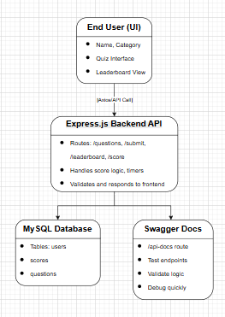
Architecture Diagram
Frontend (React.js + MUI):
Renders views (/, /quiz, /score, /leaderboard)
Axios for API calls
Countdown timer, answer logic
Backend (Node.js + Express.js):
RESTful API routes
Validates scores, enforces rank logic
Swagger at /api-docs
Database (MySQL):
users, questions, user_scores
Optimised for category filter and leaderboard lookups

Slide 7
User Stories
# | User Story Title | Description | Priority | Notes
1 | Choose Quiz Category | As a user, I can pick a category before the quiz begins. | High | History, Rules, Miscellaneous, Records, Players.
2 | Timed Questions | As a user, I can answer each question within a time limit. | High | Uses Timer component
3 | Score Summary | I want to see my score, time taken, and review answers. | High | Uses ScoreScreen page
4 | Compare with Leaderboard | See how many scores rank compared to others in real time. | High | Leaderboard ranks
5 | Replay or Switch Category | I can return to homepage and play a different quiz. | Medium | Encourages reengagement
6 | Submit Score Persistently | Score should store in DB and rank even with ties. | High | Shared-rank logic used.

Slide 8
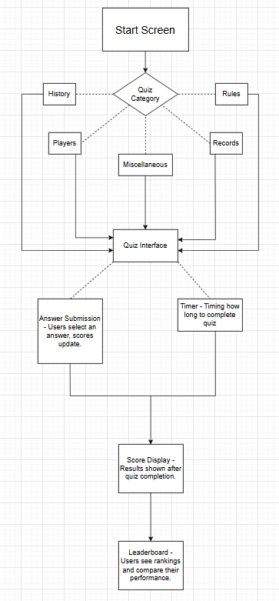
User Flow Diagram

Slide 9
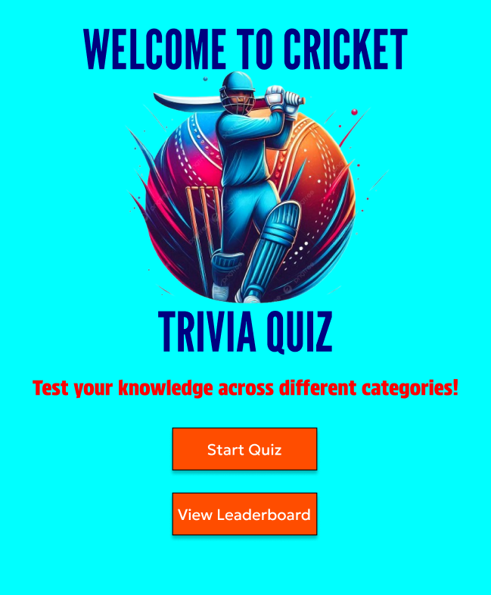
Figma Mockup Design – Start Screen (Home Page)

Slide 10
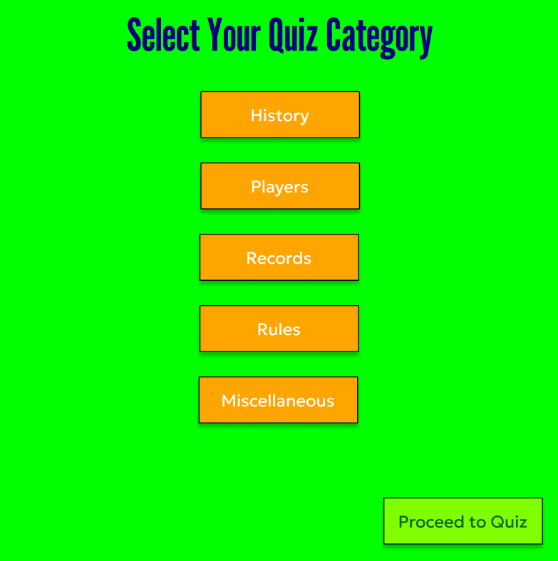
Figma Mockup Design – Category Selection Popup

Slide 11
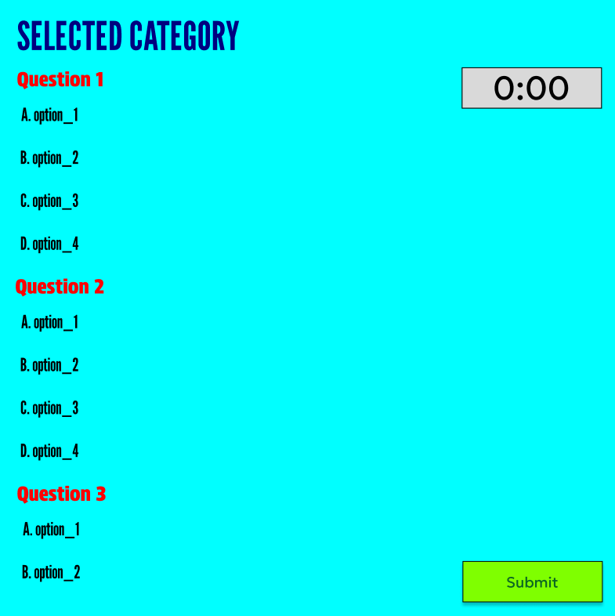
Figma Mockup Design – Category Selection Popup

Slide 12
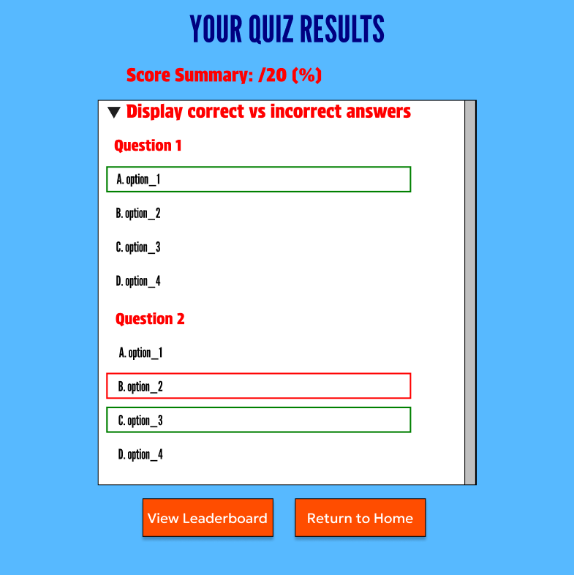
Figma Mockup Design - Score Display (After Quiz)

Slide 13
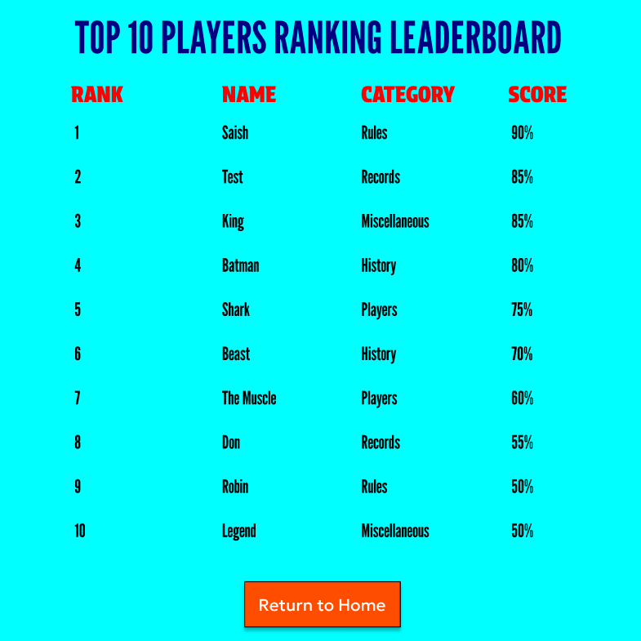
Figma Mockup Design – Leaderboard Screen

Slide 14
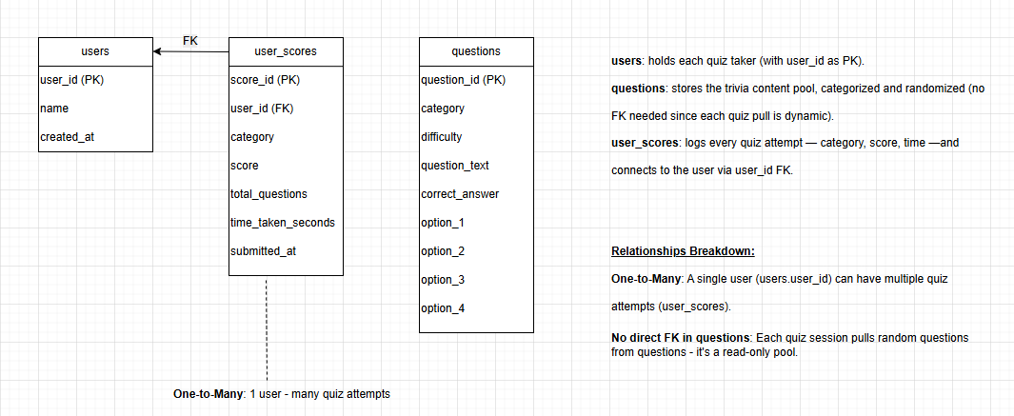
Database Design

Slide 15
Out of Scope Features
Email Login & Authentication System
Admin dashboard for adding questions
Real-time multiplayer or PVP quiz battles
Push notifications

Slide 16
Non-Functional Requirements
Requirement | Description
Security | No user credentials stored; only name used during quiz session.
Performance | 1000 sessions/hr; lazy-loaded question set, optimised SQL.
Usability | Simple UI with MUI, responsive views, large clickable buttons.
Speed | Load time less than 1s, answer transition less than 300ms.
Reliability | Recoverable quiz state (handled via props/state on refresh).
Maintainability | Swagger API, modular backend routes, MySQL schema, dotenv usage.

Slide 17
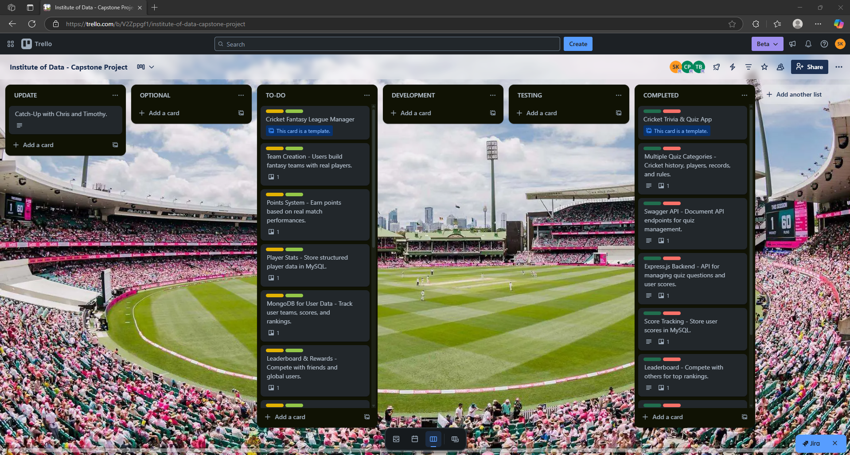
Project Plan & Timeline – Trello Board

Slide 18
Project Plan & Timeline – Capstone Project Task
Cricket Trivia & Quiz App (Priority 1)
Multiple Quiz Categories – Cricket history, players, records, and rules.
Timed Quizzes – Users answer within a set time limit.
Score Tracking – Store user scores in MySQL.
Leaderboard – Compete with others for top rankings.
React.js UI – Interactive quiz interface with Bootstrap & Material UI.
Express.js Backend – API for managing quiz questions and user scores.
Swagger API – Document API endpoints for quiz management.

Slide 19

Project Plan & Timeline – Phase 1
Phase 1: Planning & Setup (Week 1):
Define Core Features:
Multiple quiz categories (e.g., History, Players, Rules, Records, Miscellaneous)
Timed quizzes, scoring, and leaderboard
UI Wireframes & Flow Design:
Homepage → Category selection → Quiz → Score → Leaderboard
Tech Stack Decisions:
Frontend: React.js, Bootstrap, Material UI
Backend: Node.js + Express.js
Database: MySQL for questions, users, and scores
Initialize GitHub Repository and project structure

Slide 20

Project Plan & Timeline – Phase 2
Phase 2: Backend Development (Week 2–3):
Set Up Express Server and RESTful routes
Create API Endpoints:
GET /api/quiz/categories
GET /api/quiz/questions
POST /api/quiz/submit
GET /api/quiz/leaderboard
Database Design:
users: player info
questions: trivia content
user_scores: submitted scores per category
Swagger Integration: Document all routes at /api-docs

Slide 21

Project Plan & Timeline – Phase 3
Phase 3: Frontend Development (Week 4–5):
Build UI Components:
CategoryPopup modal
QuizInterface with countdown timer
ScoreScreen for results and review
Leaderboard for rankings
Implement Routing & State Management
Styling & Responsiveness: Apply Material UI + Bootstrap

Slide 22

Project Plan & Timeline – Phase 4
Phase 4: API Integration & Gameplay Logic (Week 5–6):
Connect Frontend to Backend via Axios
Timed Quiz Logic: Disable input on timeout
Score Submission: POST to backend and reflect in leaderboard
Rank Logic: Shared rank for tied scores, animated transitions

Slide 23

Project Plan & Timeline – Phase 5
Phase 5: Testing & Optimization (Week 6–7):
Unit Testing with Vitest: Timer, Score calculation, UI routing
API Testing: Swagger + Axios responses
Edge Case Handling:
Empty user name
Incomplete quiz submission
Duplicate/tied scores
Performance Optimization: Mobile layout, animation speed, button feedback

Slide 24

Testing Strategy – Steps to Ensure Product Quality
Implemented unit tests using Vitest and @testing-library/react.
Used modular testing for each feature (Timer, CategoryPopup, ScoreScreen).
Integrated Axios and React Router mocks to isolate component logic.
Manual exploratory testing for layout responsiveness, route navigation, and user interaction flow.
Backend API tested via Swagger and Thunder Client.

Slide 25

Testing Strategy – Feature-Level Testing
Timer Component: Verified countdown, input lock on timeout.
Category Popup: Tested modal open/close, category selection, validations.
ScoreScreen: Ensured score, time, and answer review display accurately.
Leaderboard: Validated shared-rank logic and API data rendering.
Routing & UX: Checked flow across homepage, quiz, score, leaderboard
API Endpoints: Swagger tests for /categories, /questions, /submit, /leaderboard.

Slide 26
Testing Strategy – Edge Case Handling
Empty Username: Triggers alert and prevents quiz start.
Timeout Scenarios: Auto-disables options after time runs out.
Incomplete Quiz Submission: Prevented partial scores from being stored.
Tied Scores: Shared rank logic implemented to ensure fairness.
Repeated Renders: Fixed leaderboard duplicate rendering bugs via unique keys and state guards.

Slide 27

Implementation Overview
Hosted frontend on http://localhost:5173/
Express.js backend at http://localhost:5000/
MySQL connection managed via .env
Data validated on backend before submission
Swagger served at /api-docs for dev/test team

Slide 28
End-to-End Solutions
Goal | Status
Testing coverage and mocks | ✓
Category-driven question randomiser | ✓
Responsive frontend with routing | ✓
Accurate leaderboard ranking | ✓
Score saving with category and user | ✓

Slide 29
References & Tools
GitHub: https://github.com/saishk98/IoD-CapstoneProject
Figma: https://www.figma.com/design/MYwO4mNtgHfJv63vHSFrj1/Institute-of-Data--IOD----Capstone-Project?m=auto&t=TDuznfvC5VnRUZWe-6
Trello: https://trello.com/b/V2Zppgf1/institute-of-data-capstone-project
Tech Stack & Tools:
Frontend: React.js, CSS, BootStrap.css, Material UI, Axios, Vitest.
Backend: Node.js, Express.js, MySQL, Swagger API, Thunder Client.

Slide 30
Thank You / Q&A
“Cricket is more than a sport – it’s strategy, stats, and passion. This apps bring it all together.” Questions welcome!

